Slide 1
11KW OBC
NPC Tuning & Simulation
PREPARED BY
Vinoth Kumar
2022/12/22

Slide 2
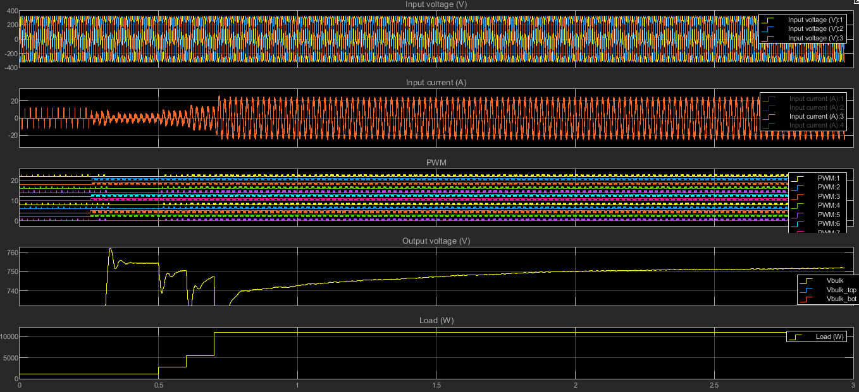
Simulation Results from Sandeep

Slide 3
Simulation Results With VCAP Initial V @ 0V

Slide 4
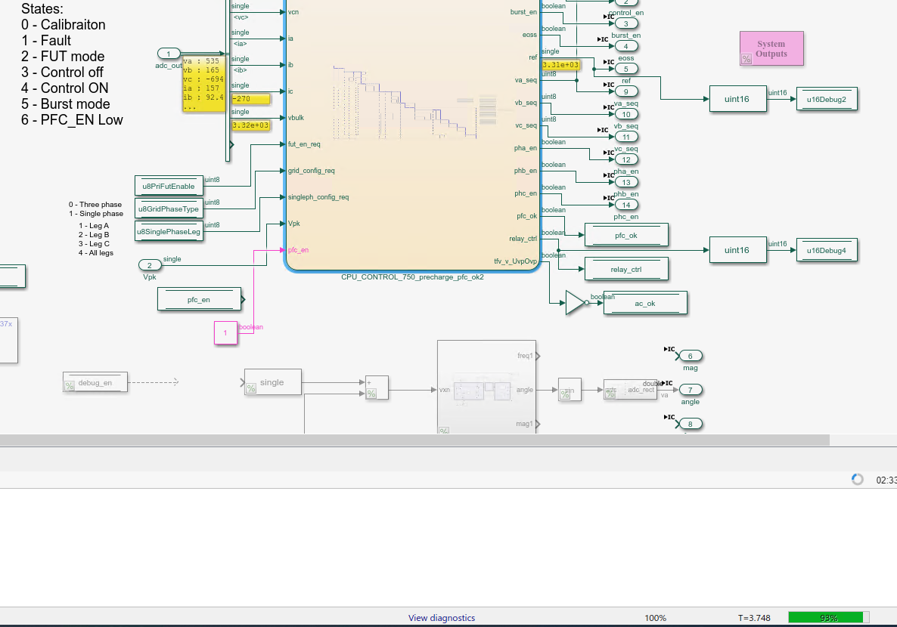
Simulation Results – With VCAP Initial V @ 0V

Slide 5
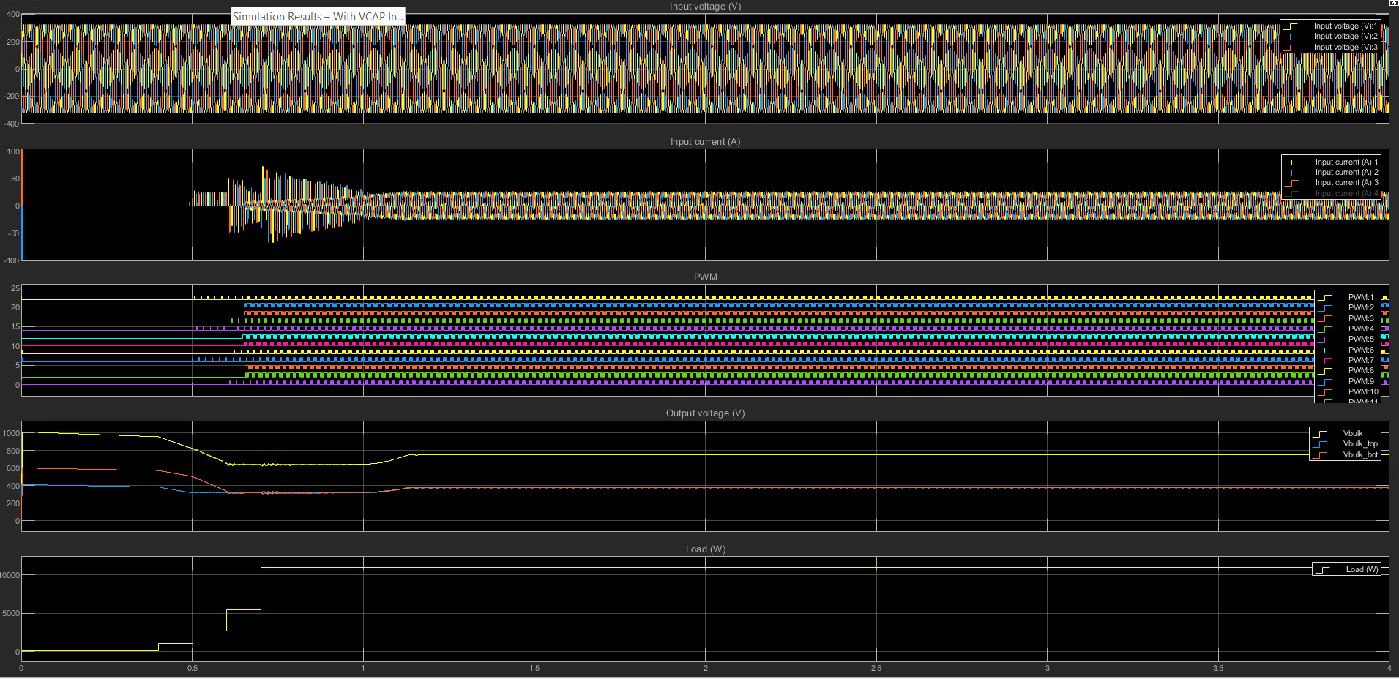
Simulation Results – With VCAP Initial V @ 0V

Slide 6
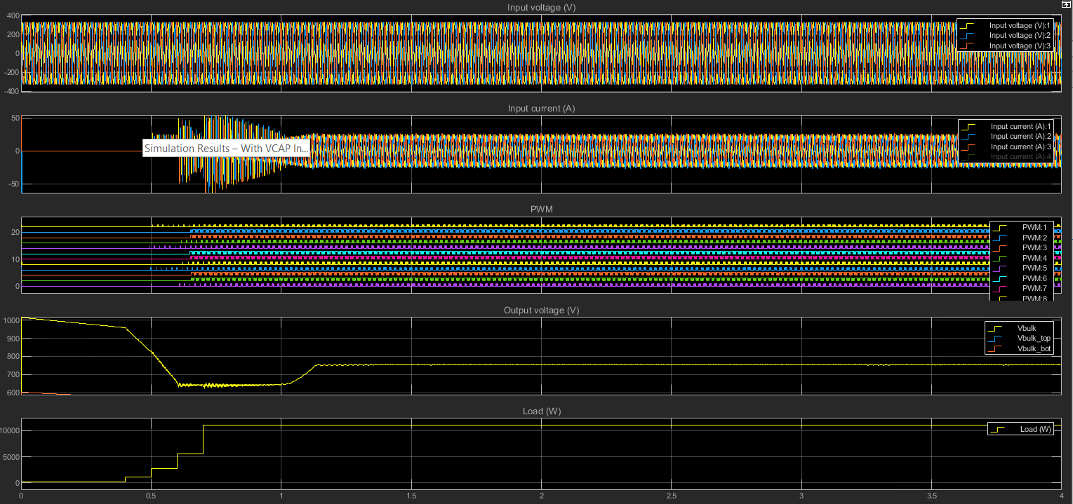
Simulation Results – With VCAP Initial V @ 0V

Slide 7
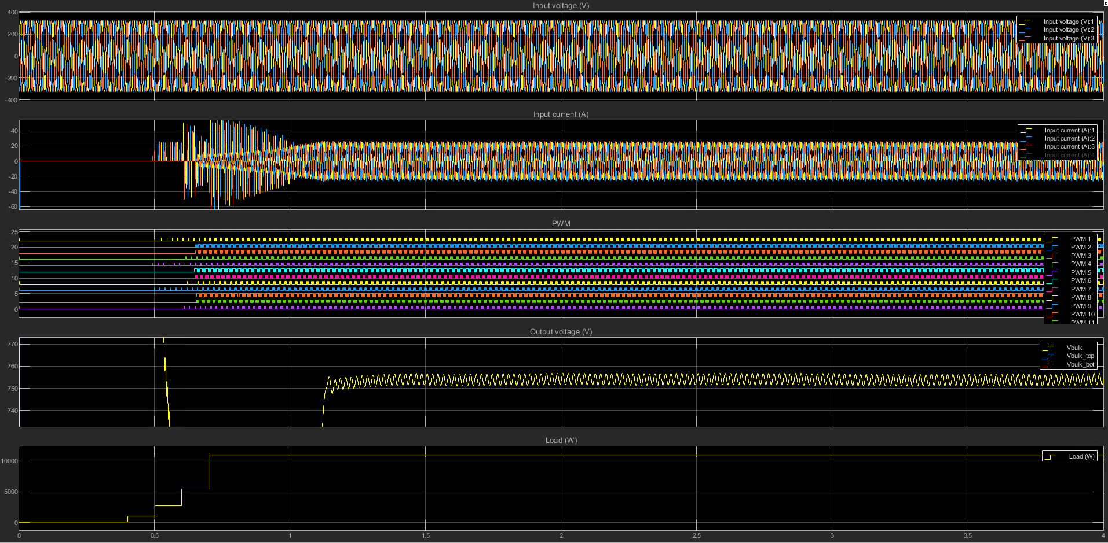
Simulation Results – With VCAP Initial V @ 0V

Slide 8
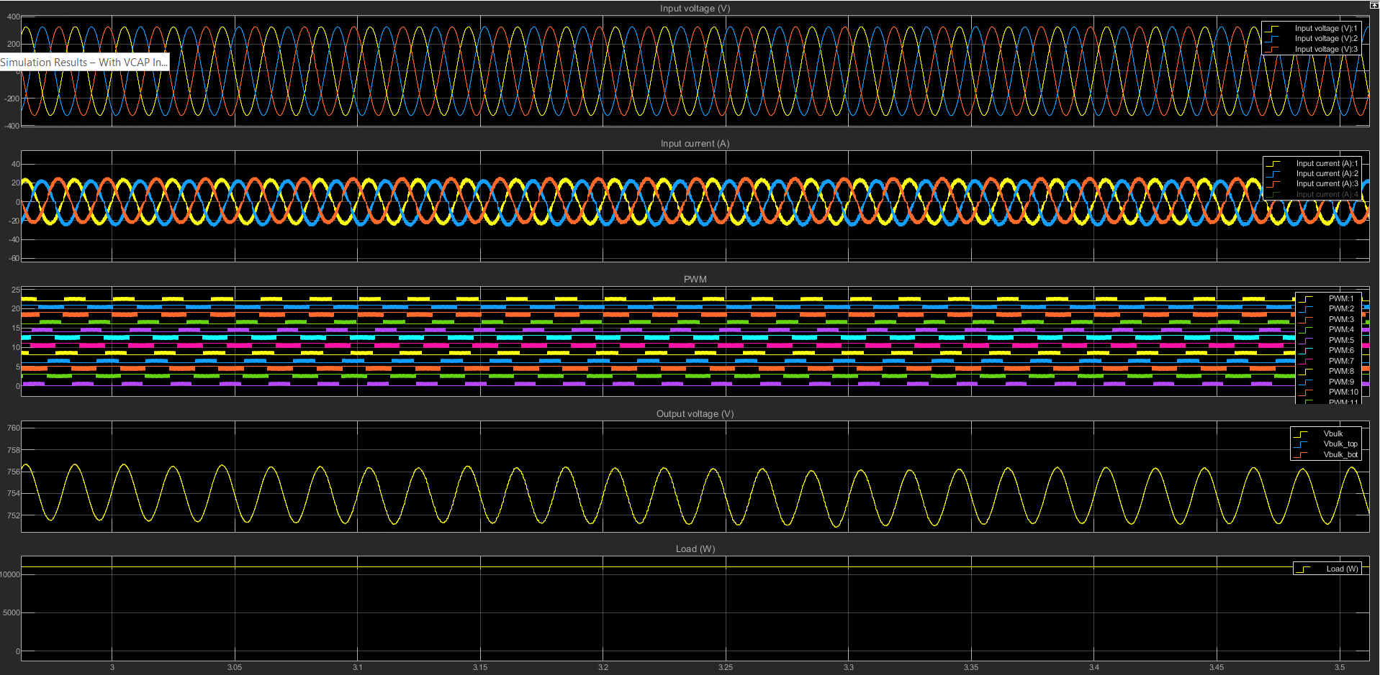
Simulation Results – With VCAP Initial V @ 0V

Slide 9
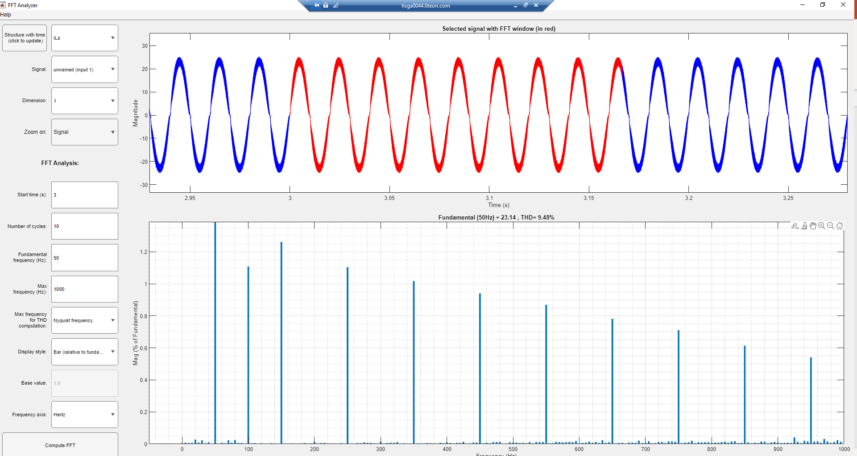
Simulation Results – With VCAP Initial V @ 0V

Slide 10
Simulation Results With VCAP Initial V @ Vrms*Sqrt(2)

Slide 11
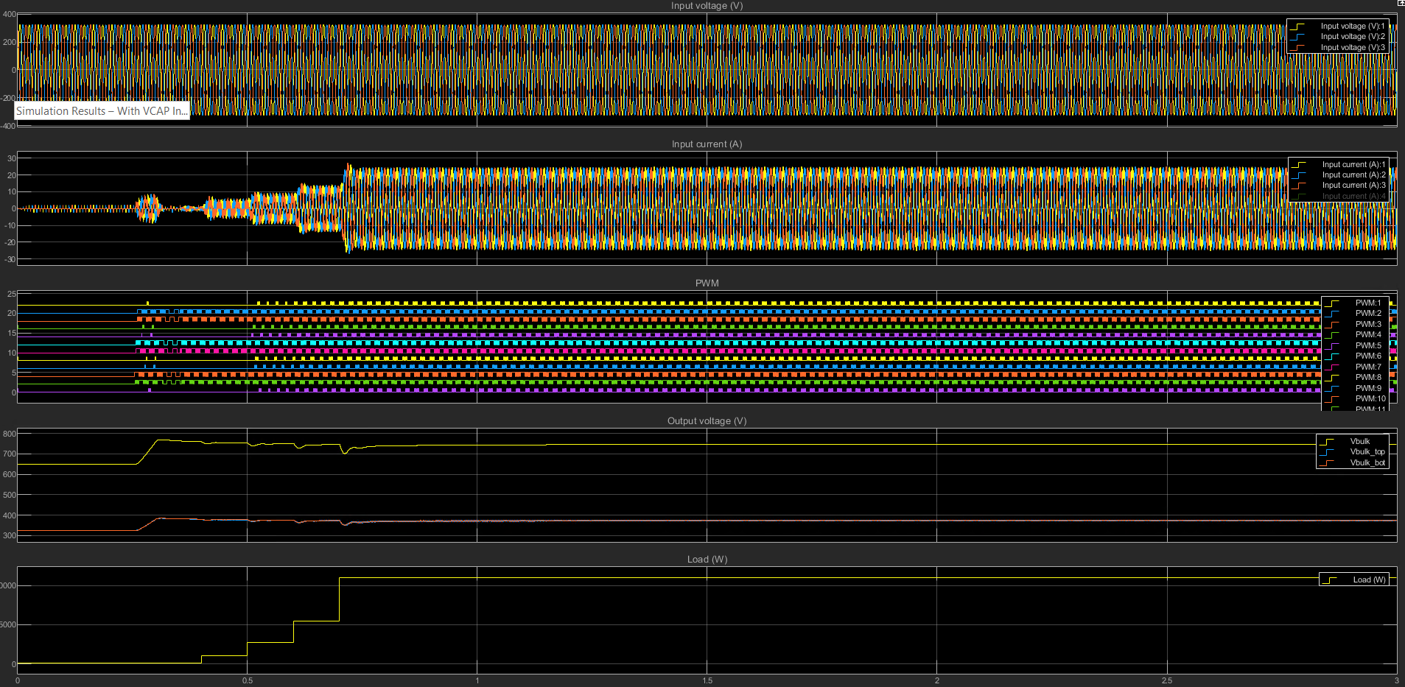
Simulation Results – With VCAP Initial V @ Vrms*Sqrt(2)

Slide 12
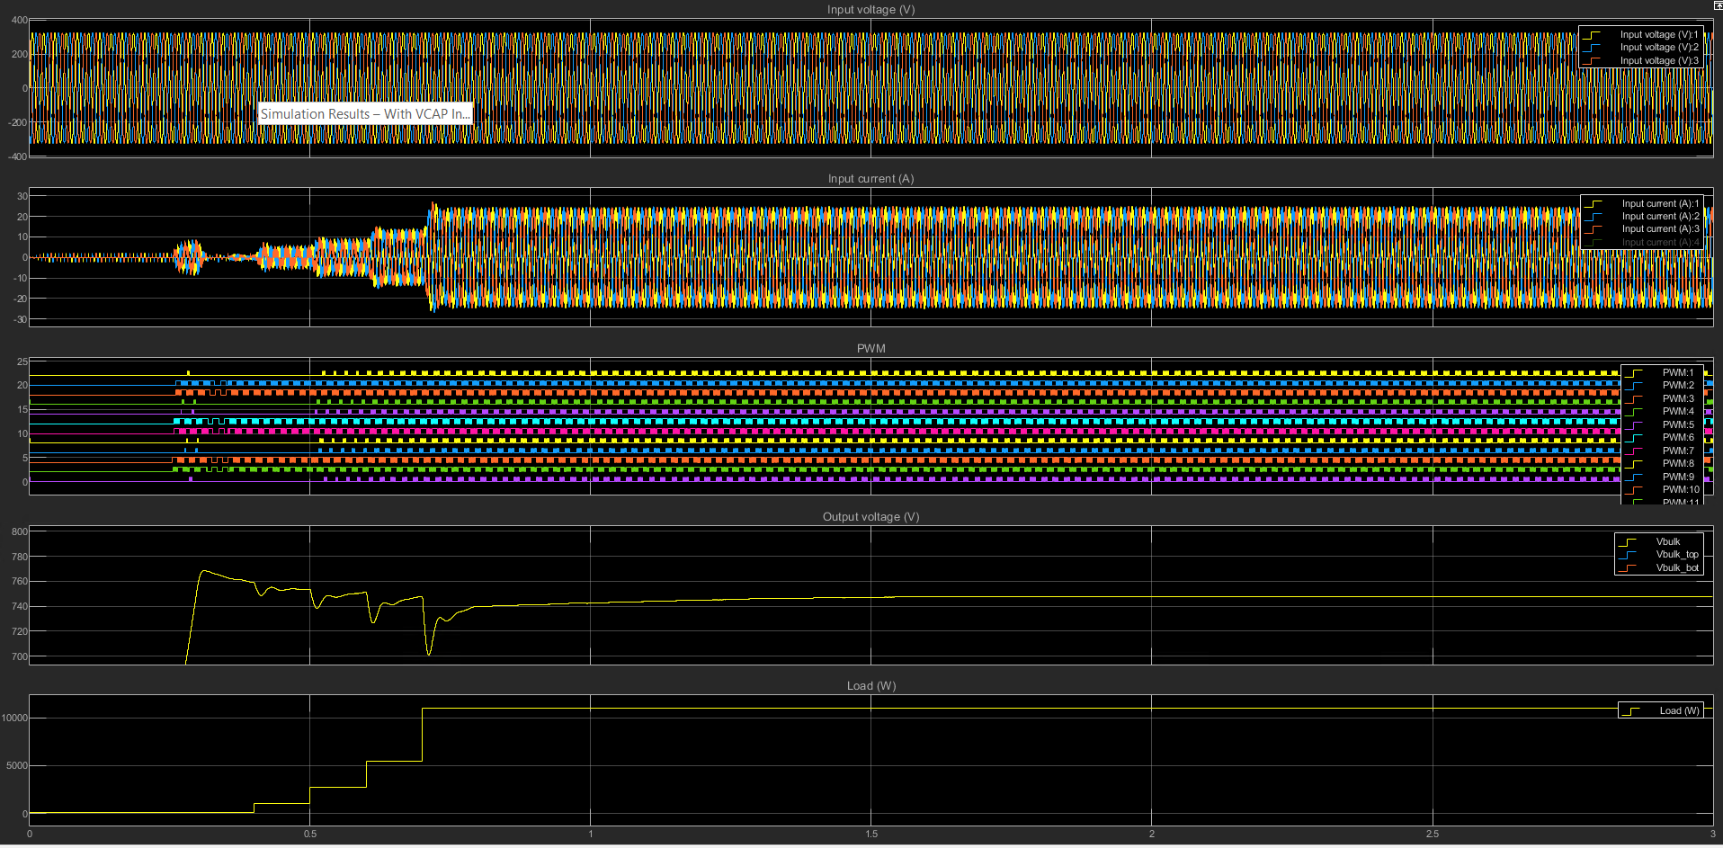
Simulation Results – With VCAP Initial V @ Vrms*Sqrt(2)

Slide 13
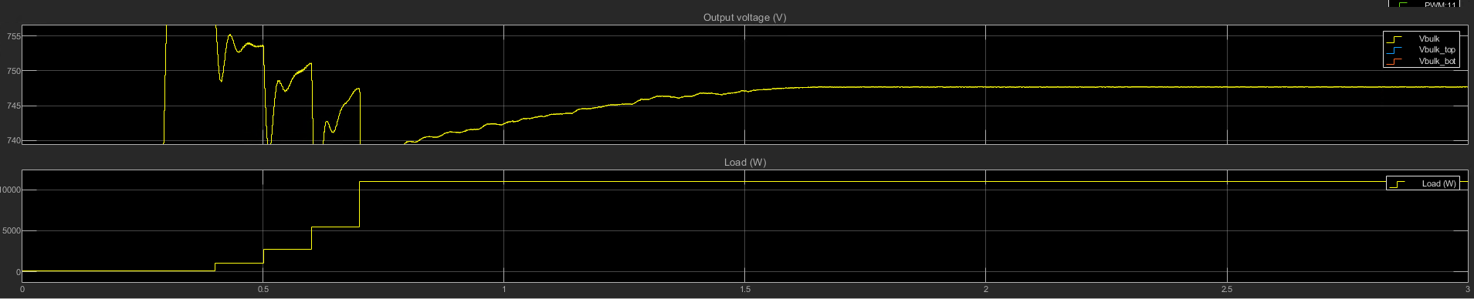
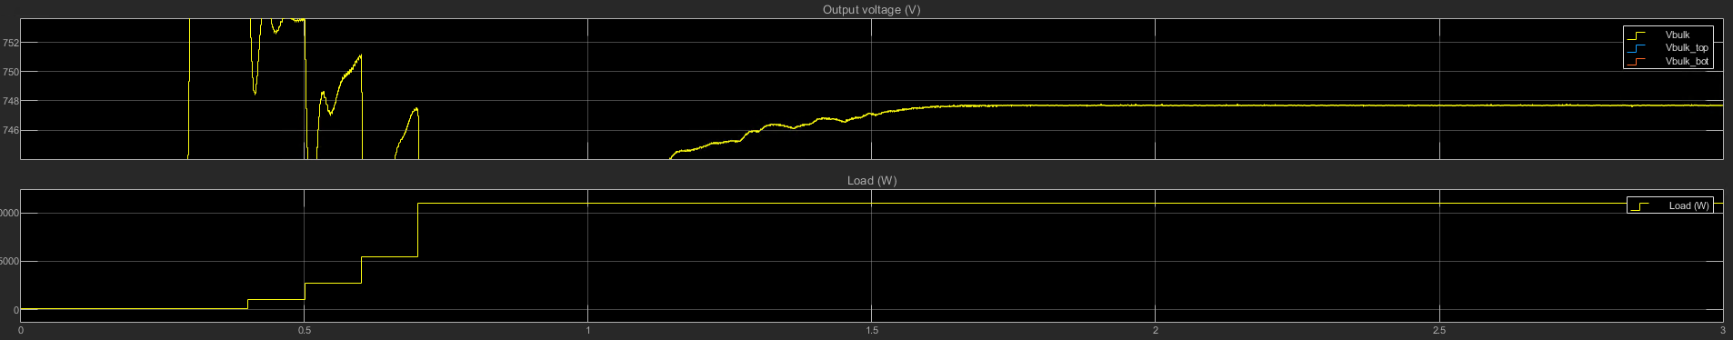
Simulation Results – With VCAP Initial V @ Vrms*Sqrt(2)

Slide 14
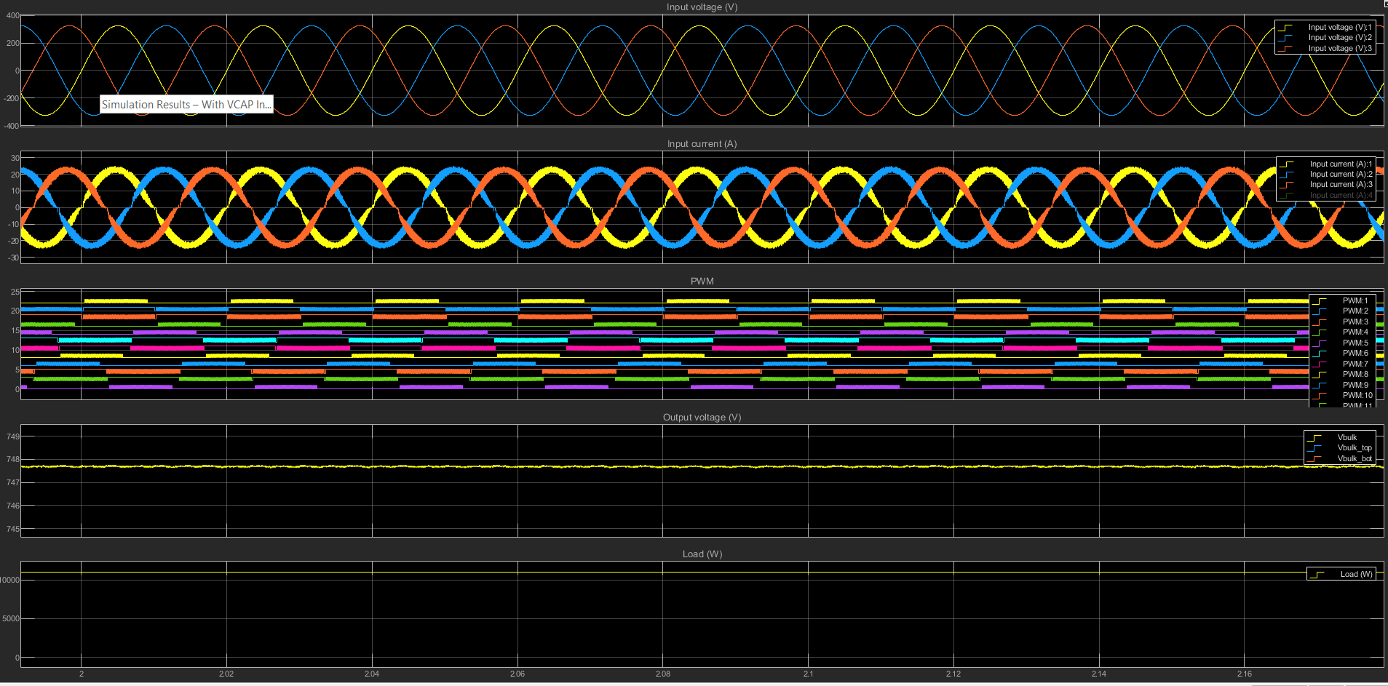
Simulation Results – With VCAP Initial V @ Vrms*Sqrt(2)

Slide 15
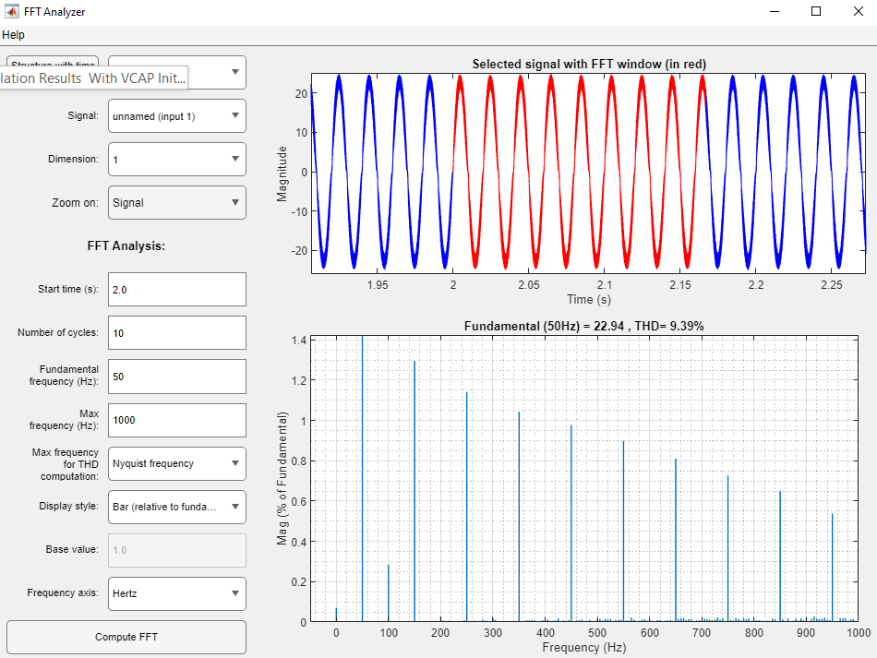
Simulation Results – With VCAP Initial V @ Vrms*Sqrt(2)

Slide 16
Control Loop Tuning (Existing Design)

Slide 17
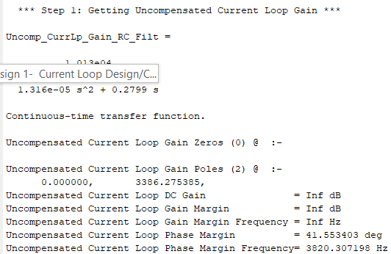
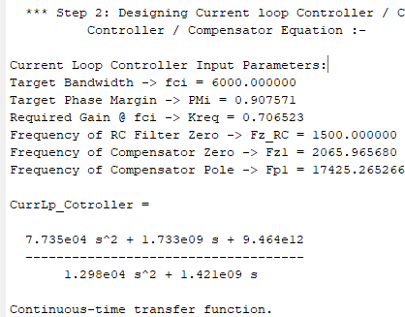
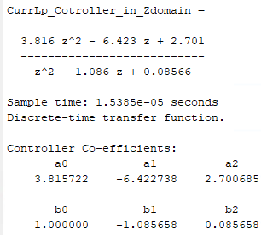
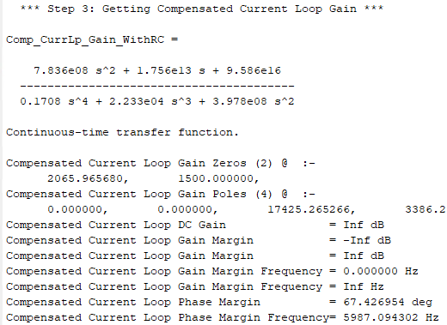
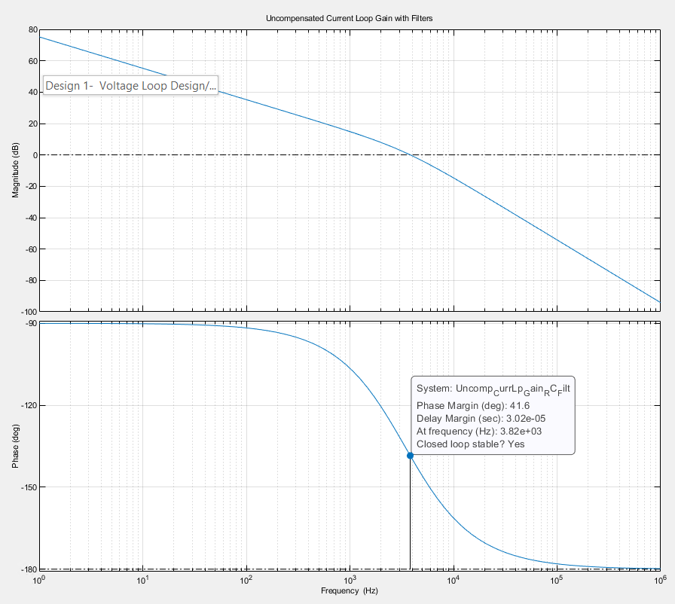
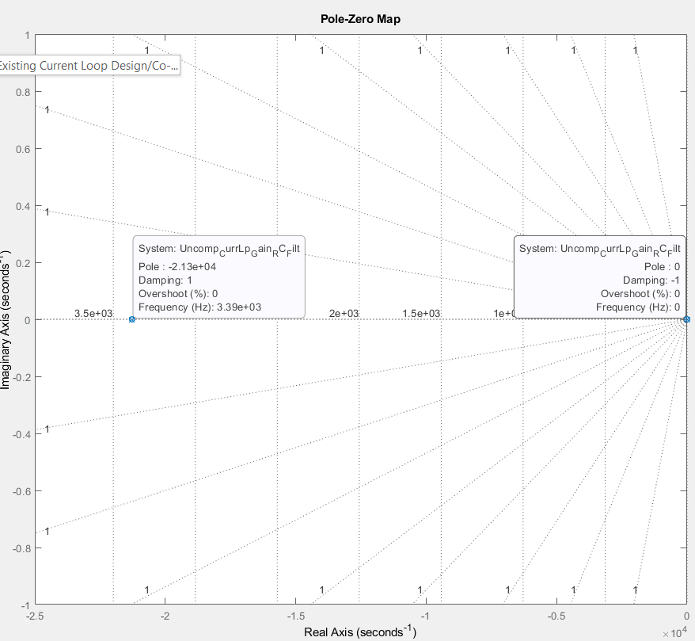
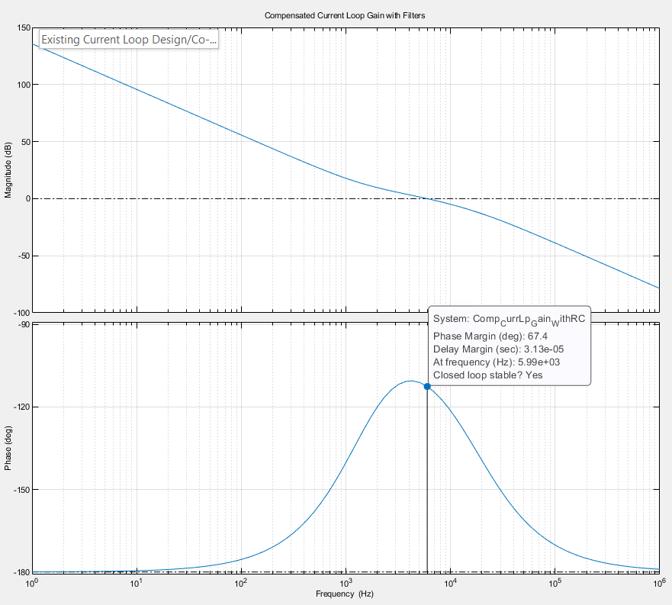
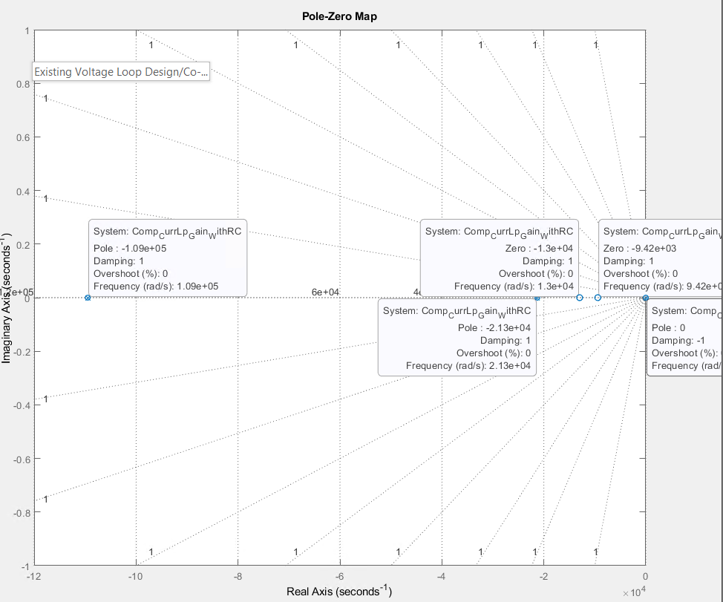
Existing Current Loop Design/Co-efficients

Slide 18
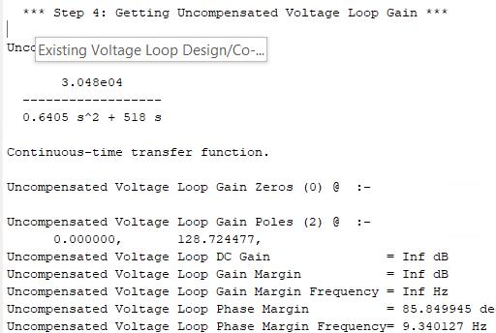
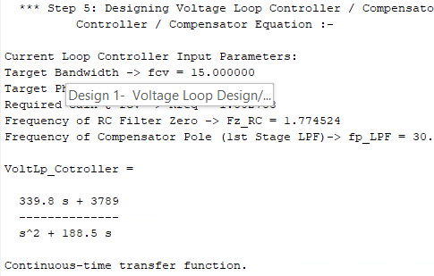
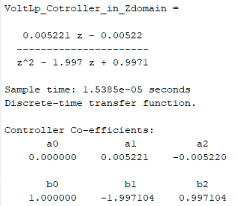
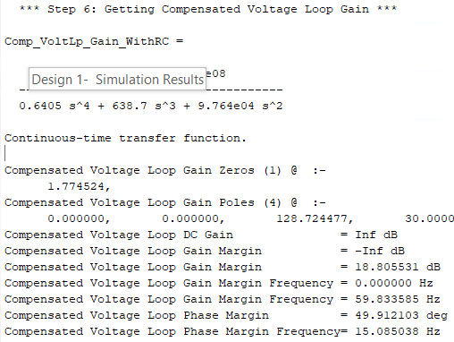
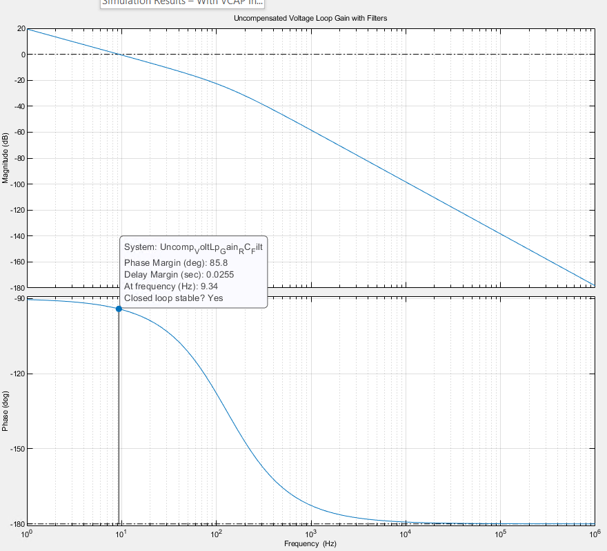
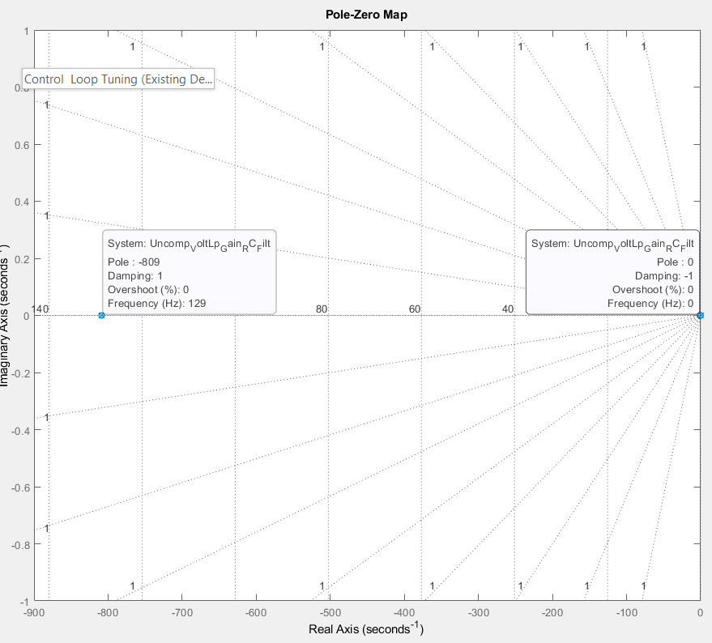
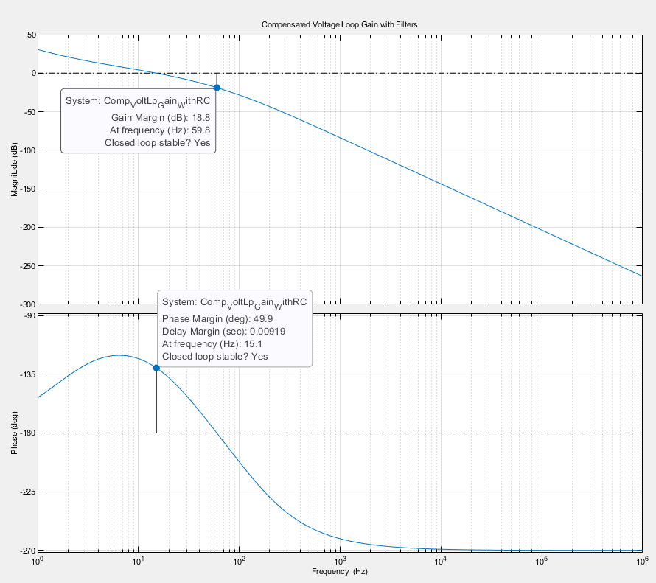
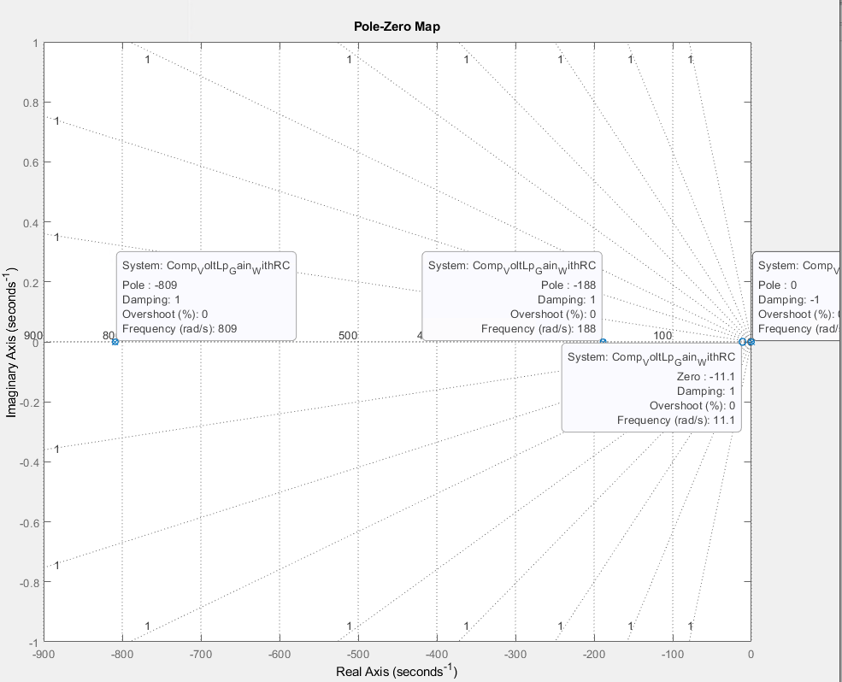
Existing Voltage Loop Design/Co-efficients

Slide 19
Control Loop Tuning (Design 1)
With 750V Target and 11KW Power

Slide 20
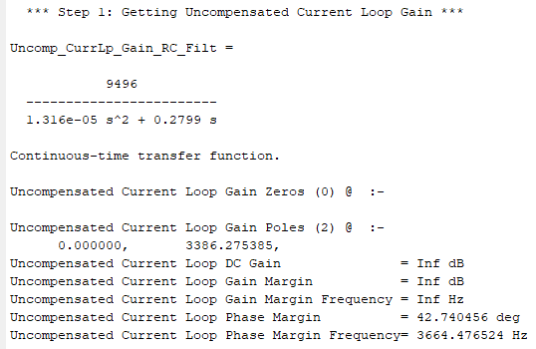
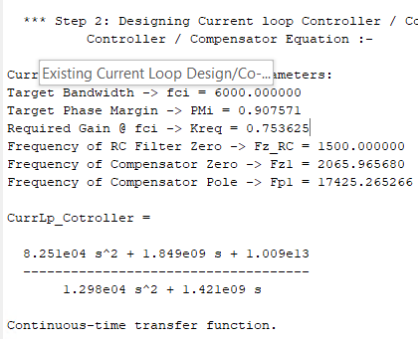
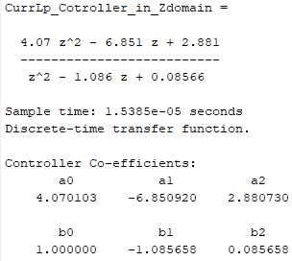
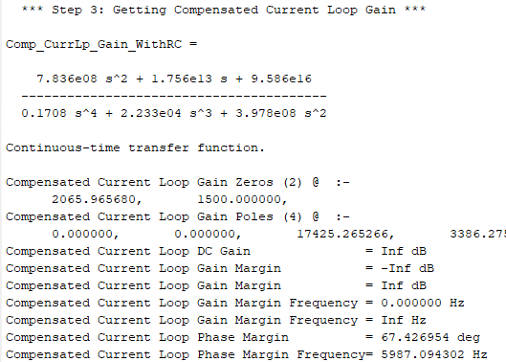
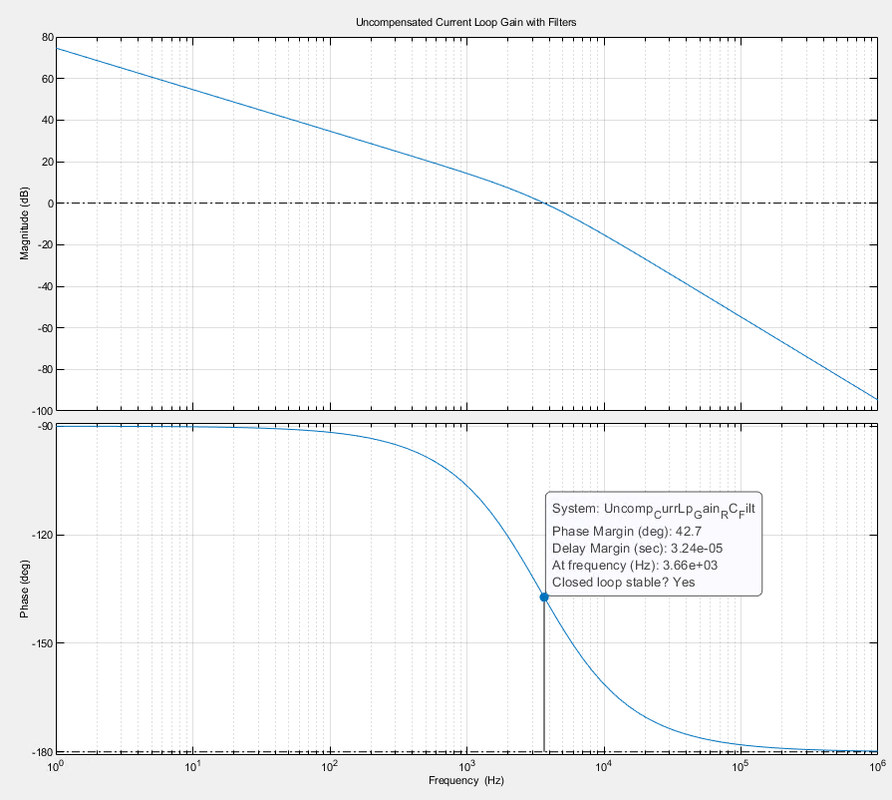
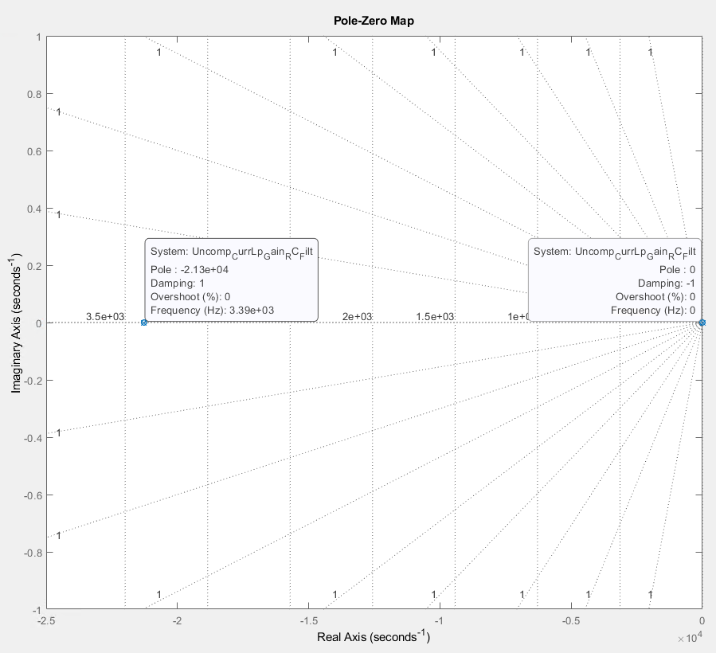
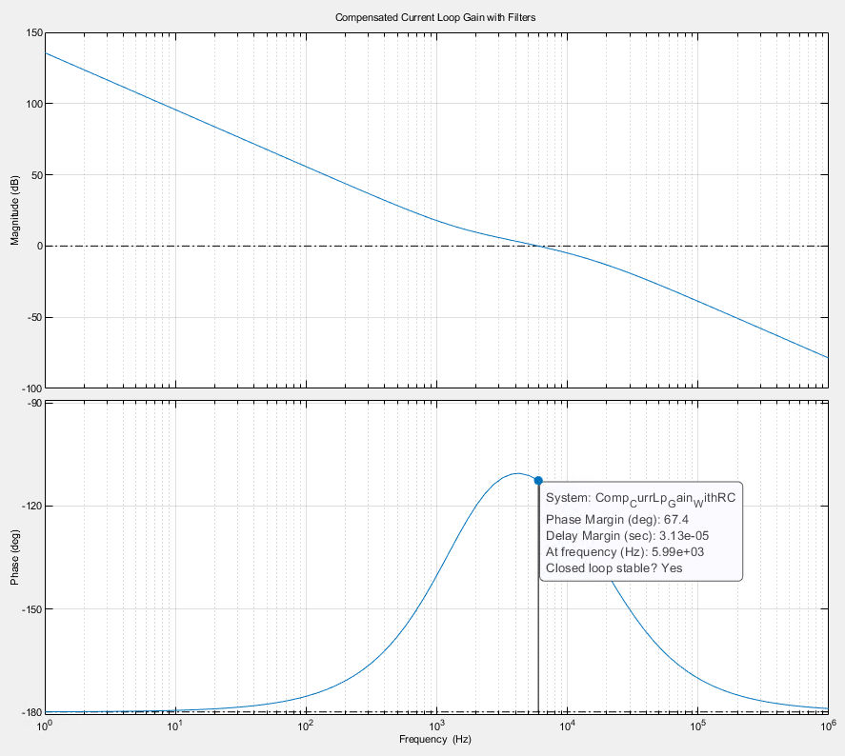
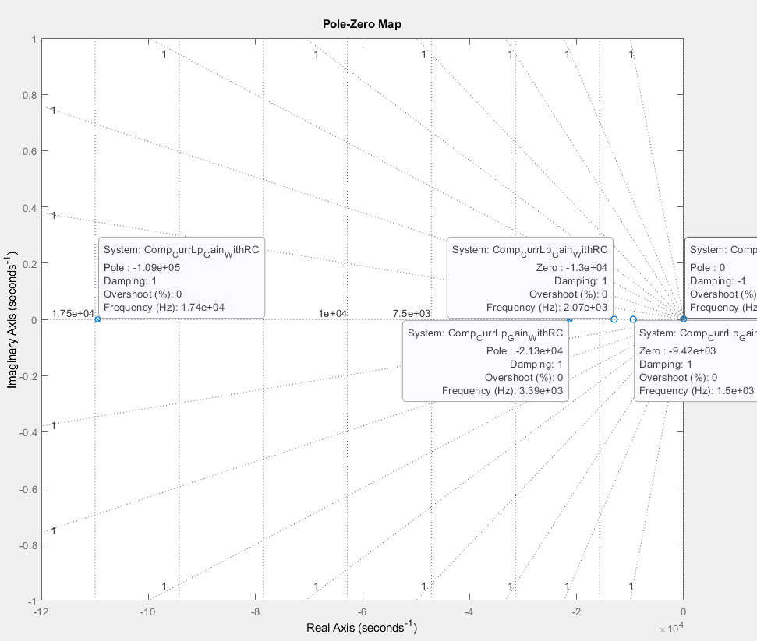
Design 1- Current Loop Design/Coefficients
With 750V Target and 11KW Power

Slide 21
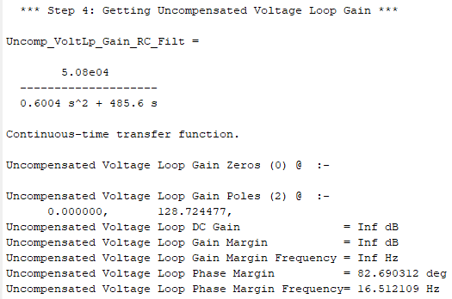
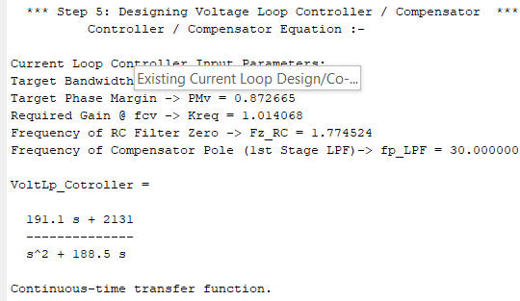
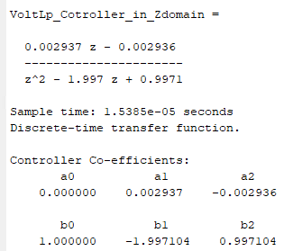
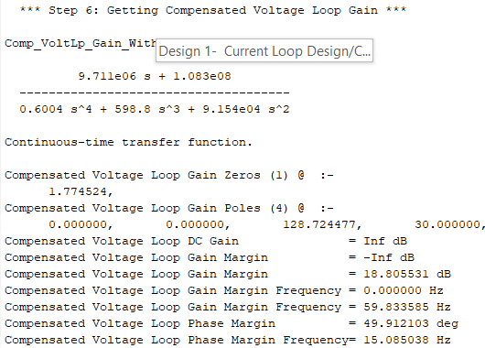
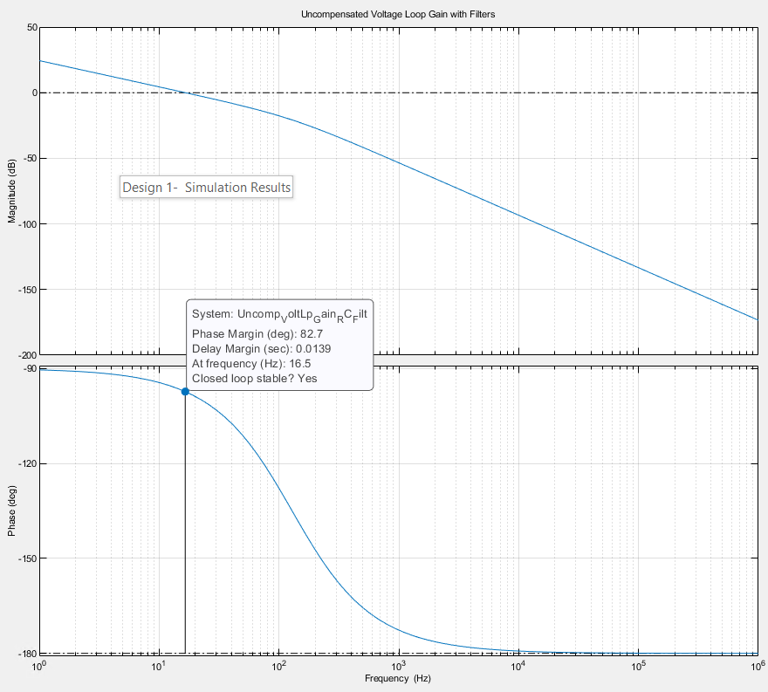
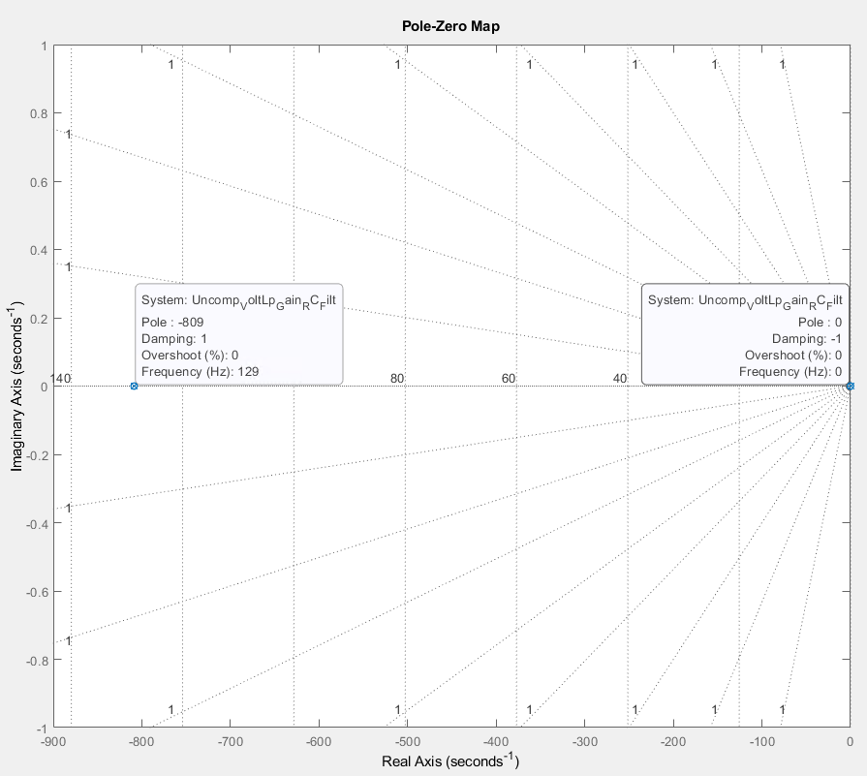
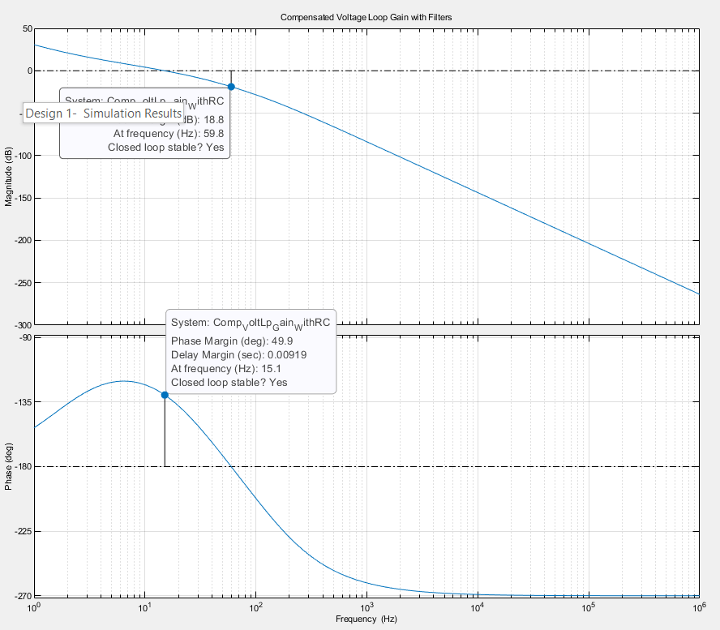
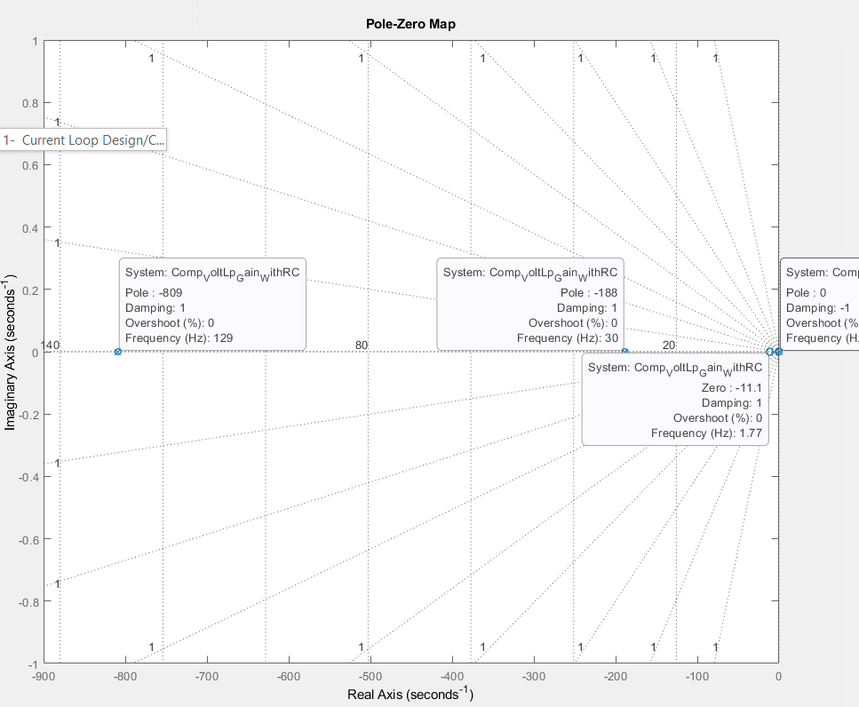
Design 1- Voltage Loop Design/Coefficients
With 750V Target and 11KW Power

Slide 22
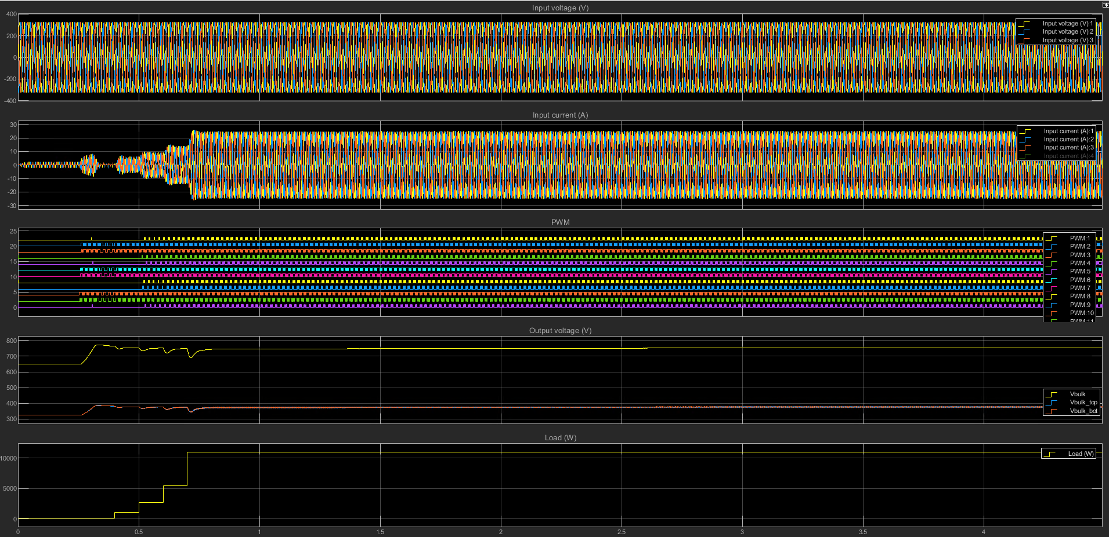
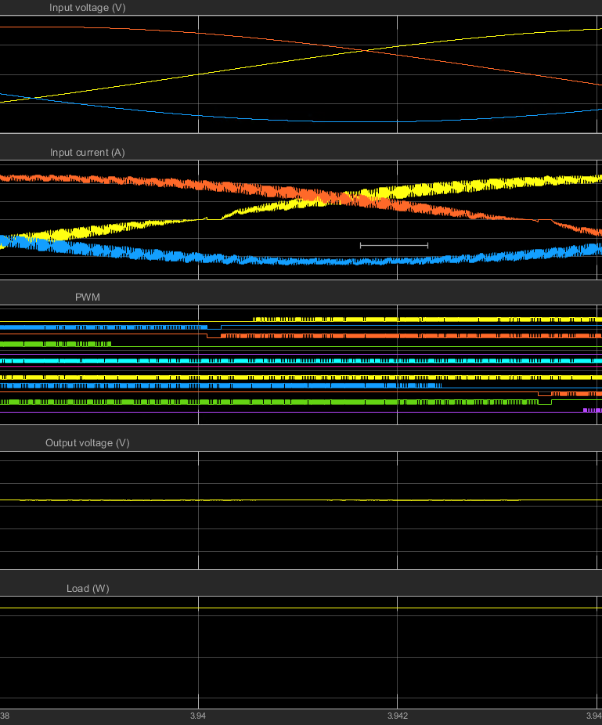
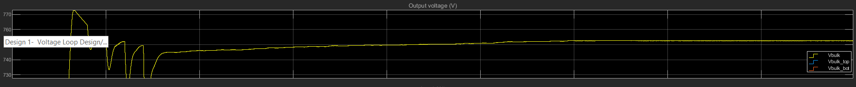
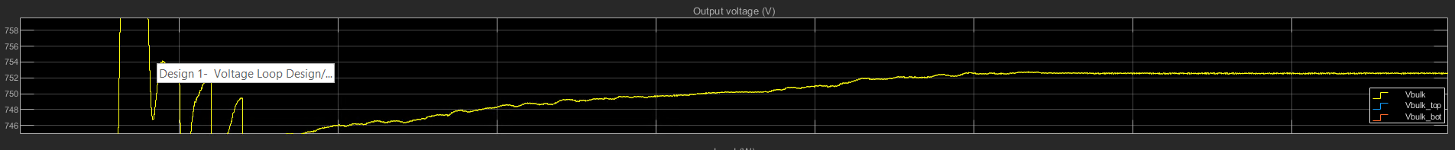
Design 1- Simulation Results
With 750V Target and 11KW Power

Slide 23
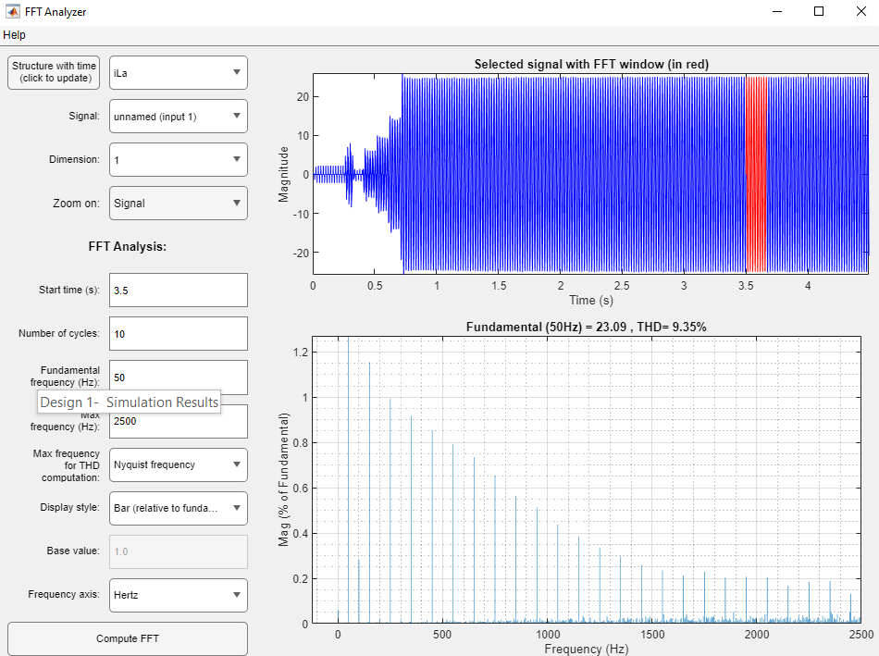
Design 1- Simulation Results
With 750V Target and 11KW Power

Slide 24
Control Loop Tuning (Design 2)
With 750V Target and 11KW Power + Voltage Loop LPF Pole @ 60’

Slide 25
Design 2- Current Loop Design/Coefficients
With 750V Target and 11KW Power + Voltage Loop LPF Pole @ 60’

Slide 26





Design 2- Voltage Loop Design/Coefficients
With 750V Target and 11KW Power + Voltage Loop LPF Pole @ 60’

Slide 27



Design 2- Simulation Results
With 750V Target and 11KW Power + Voltage Loop LPF Pole @ 60’

Slide 28

Design 2- Simulation Results
With 750V Target and 11KW Power + Voltage Loop LPF Pole @ 60’

Slide 29
Voltage Regulation During Diff. Loads Comparison with Various Compensators

Slide 30





Regulation with Existing Design
Load 30% - ~754V
Load 60% - ~751V
Load 100% - ~745V

Slide 31





Regulation with Design 2
Load 30% - ~755V
Load 60% - ~756.5V
Load 100% - ~758.5V

Slide 32




Regulation with Design 2 Voltage Loop Coefficients Only
Load 30% - ~755V
Load 60% - ~756.5V
Load 100% - ~758.5V

Slide 33
Control Loop Tuning (Design 3)
With 750V Target and 11KW Power + Voltage Loop LPF Pole @ 60’

Slide 34

Design 2- Current Loop Design/Coefficients
With 750V Target and 11KW Power + Voltage Loop LPF Pole @ 60’

Slide 35
Design 2- Voltage Loop Design/Coefficients
With 750V Target and 11KW Power + Voltage Loop LPF Pole @ 60’

Slide 36
Design 2- Simulation Results
With 750V Target and 11KW Power + Voltage Loop LPF Pole @ 60’

Slide 37
Design 2- Simulation Results
With 750V Target and 11KW Power + Voltage Loop LPF Pole @ 60’

Slide 38
Thank You
Connect with LITEON

